Slide 1
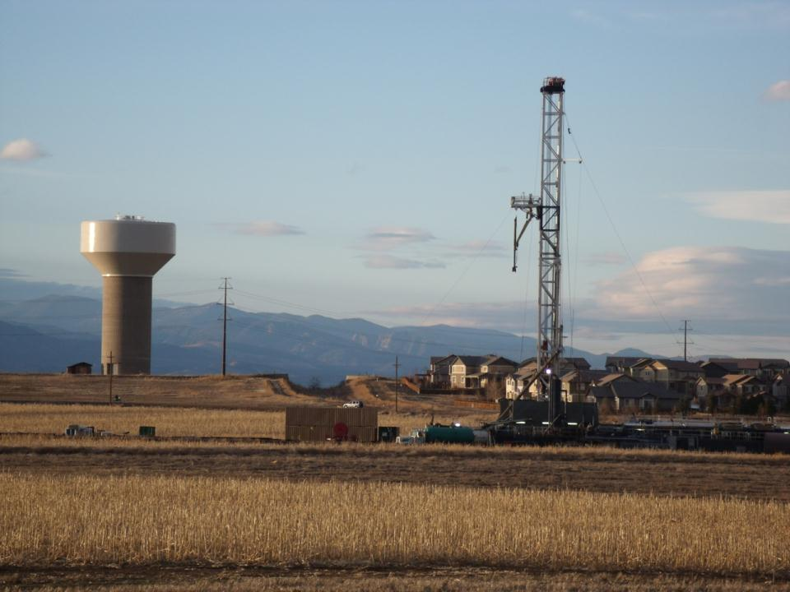
Is shale gas extraction good for climate?
Gabrielle Pétron
Cooperative Institute for Research in Environmental Sciences
University of Colorado, Boulder, CO

Slide 2
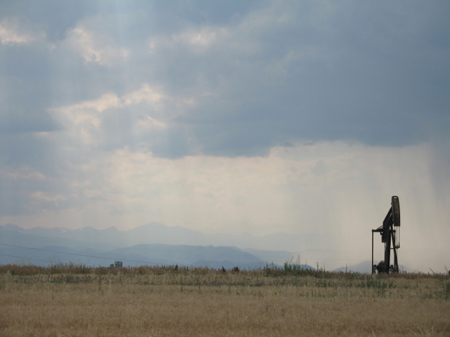
Any opinions, findings, and conclusions or recommendations expressed in this material are those of the author and do not necessarily reflect the views of the US National Oceanic and Atmospheric Administration, the University of Colorado at Boulder, or the US National Science Foundation.

Slide 3

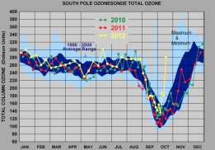
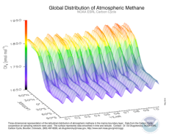
NOAA Global Monitoring Division Primary Mission: Long-term High Quality Measurements of the Atmosphere Properties
Climate Forcing – Stratospheric Ozone – Air Quality
http://esrl.noaa.gov/gmd/dv/iadv/
Calibrated – Long-term – Transparent – Publicly available

Slide 4
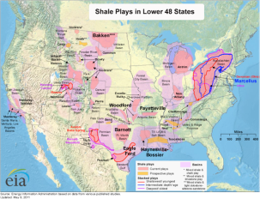
Unconventional NG in the US
Benefits & Challenges
Sharp decline rate of well production
Heterogeneity of results (sweet spots)
Water availability, recycling and disposal
Regional air quality impacts (surface ozone)
Global climate impacts
Need to expand infrastructure to reduce flaring in oil fields
The public, local governments in some areas are divided
Cheap energy source
Large domestic reserves
Cleaner burning than coal
Existing infrastructure, technical know-how (jobs)
Strong federal and state governments support
Mineral rights belong to private entities (not always true in the West)
EIA
EIA

Slide 5
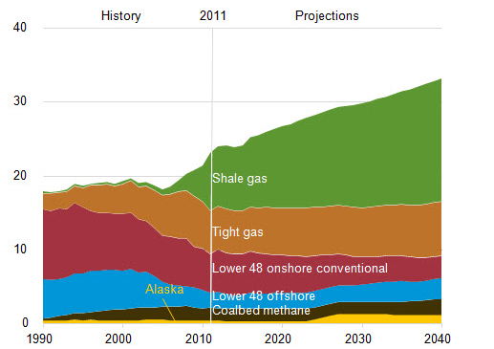
US Increasing Reliance on Unconventional Gas
2011 in the US:
3414 new shale gas wells &
6759 new shale oil wells
Expenditures: 65.5 billion $
Source: API, 2013
US Dry Gas Production Tcf
*
2011 US production
~ 20% of world production
*
*
* Shale gas, tight gas and coalbed methane are also called unconventional gas.
Source: US Energy Information Administration, AEO2012

Slide 6
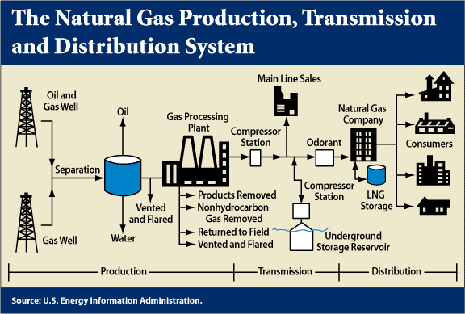
How to assess the climate benefits of natural gas?
Air emissions estimation from all segments of natural gas systems:
Production
Processing
Transmission and Storage
Distribution
Life Cycle Assessments:
estimate GHG emissions over lifetime of a well
compare GHG emissions for different fuels per unit of product (MWh for ex.)
1. Emissions from Well (re) Stimulation
High volume high pressure hydraulic fracturing or refracturing
Flowback
Mitigation (voluntary/mandatory)
2. Estimated Ultimate Recovery (EUR) (incl. lifetime of producing well)
3. Production rate over lifetime
4. Co-products Emissions (oil and gas)
Ex. Flaring/venting
Distinguish shale/tight gas, associated gas from shale/tight oil wells versus conventional gas.

Slide 7
Oil & Gas Emissions Inventories
Accurate Inventory
of Activity Data
Equipment
Operations
Production
Up-to-date emission factors
Mean
Statistical distribution
for each source type
Potential
Emissions
Actual Emissions
Documented emissions reductions/controls
(Voluntary & Mandatory)
Requirements
Harmonized source categories for all pollutants
For each source category:
Activity Data (year/month specific)
Activity/equipment counts
Production data
Emissions Statistics
Distribution Mean
Variability
Composition Profile
Controls or not (effectiveness)
Low threshold for permitting ensures inventory developers have information on small-medium size facilities
Best knowledge transparent bottom-up inventory

Slide 8
Oil & Gas Emissions Inventories
Accurate Inventory
of Activity Data
Equipment
Operations
Production
Up-to-date emission factors
Mean
Statistical distribution
for each source type
Potential
Emissions
Actual Emissions
Documented emissions reductions/controls
(Voluntary & Mandatory)
Sources
State agencies:
Oil and Gas Commission
Air Division
O&G Operators:
Reported data (EPA GHGRP)
Surveys (WRAP)
Related industries (IHS, DI Desktop,…)
Limited direct measurement studies
Emission factors (Ex: EPA/GRI, 1996)
Best knowledge transparent bottom-up inventory

Slide 9
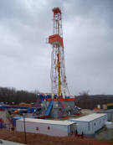
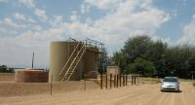
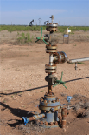
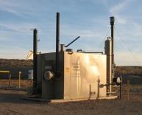
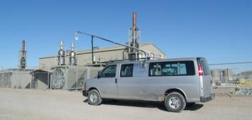
US Natural gas systems: Large infrastructure
How much gas is leaking from US natural gas infrastructure?
1,000,000 oil and gas wells
493 processing plants,
over 20,000 miles of gathering pipelines,
~ 300,000 miles transmissions pipelines,
> 1,400 compressor stations
~ 400 underground storage facilities
~ 2,000,000 miles of distribution pipelines
US Statistics: EIA, DOT, OGJ

Slide 10
What’s in natural gas?
Surface ozone precursors
Air Toxics
NGLs
Composition of gas varies from one basin/formation/well to another.
Methane (CH₄)
Produced “raw gas” is composed of 70-90% methane
Distribution gas is >90% methane

Slide 11
US EPA estimates of CH₄ emissions from NG
US EPA GHG inventory
Methane national emissions
(Tg/yr)
2010 EPA US GHG inventory
2011/2012 EPA
2013 EPA
2.5% leak rate
1.5% leak rate
Inventory-based estimates of CH₄ emissions from US NG systems
Have changed dramatically over the past 4 years
Need to be assessed by independent methods

Slide 12

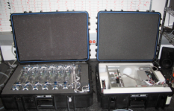
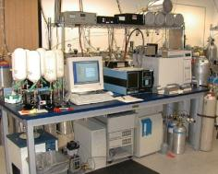
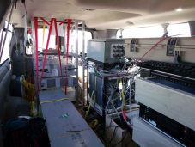


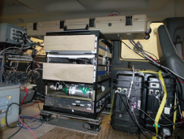
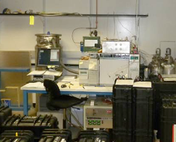

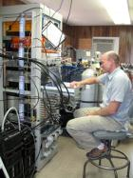
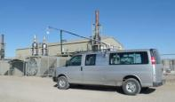
How do we measure the air composition to track Emissions and Air Impacts?
Tower, aircraft, balloon and van
in-situ and canister sampling sampling system
CCGG MAGICC
CO₂ CH₄ N₂O SF₆ CO H₂
HATS GC/MS
43 species
Notes:
CCG global network: 34 sites, flask pairs analyzed by D. Helmig at INSTAAR since 2004, HATS global network 15 sites; Regional North American network: 8 towers and 14 airplane sites 2007 to present

Slide 13
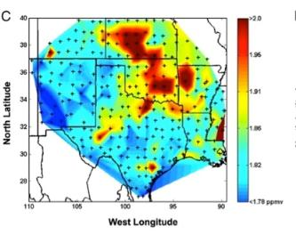
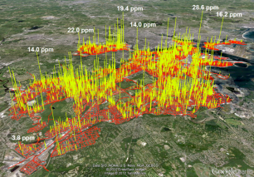
Atmospheric Impacts from Oil and Natural Gas Systems
Surface enhancements of alkanes and alkylnitrates in Texas & Oklahoma, Katzenstein et al., 2003
Field measurements in the US suggest that methane and Volatile Organic Compounds (VOCs) emissions are likely under-estimated by inventories:
Oil and gas production
in TX, OK, KS: Katzenstein et al. PNAS, 2003
in CO and UT: Pétron et al., JGR, 2012, Karion et al., GRL, 2013
Natural gas distribution in cities
In Boston: Phillips et al., EP, 2012
In Washington DC: Jackson et al., on-going
CH₄
Methane leaks in Boston,
Phillips et al., 2012

Slide 14

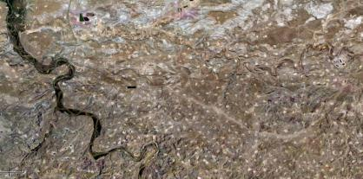

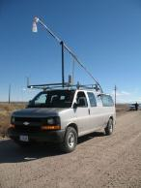

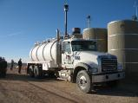



Can we detect CH₄ emissions in the atmosphere?
CH₄ “cloud” from surface emissions
Atmospheric measurements
wind
Ambient levels of CH₄ measured by tower, instrumented van or aircraft downwind of the area source reflect emissions from oil and gas production operations
Notes:
What are these pictures of? Potential emissions of different mixes depending on processing stage. Has impact on regional air.
Drilling rig, condensate tanks + produced water in small tank, xmas tree is wellhead, compressor station – push gas through pipeline to processing plant is central,
Separator on wellpad, truck brings produced water to a pond in Utah.
Use the atmosphere as a check on bottom-up inventory estimates

Slide 15

Mass Balance Approach for Emissions Estimation
Wind
Wind
mixing height
(PBL)
Downwind CH₄
Background CH₄
emissions
Molar CH₄ enhancement in PBL
CH₄ flux
Perpendicular wind speed
References: White et al., 1976; Ryerson et al., 2001; Mays et al., 2009
Notes:
Under the ideal meteorological conditions, we can calculate the area CH₄ flux with a low uncertainty.
Basin scale, not continental scale –
Variables are measured as I will show later, and used to estimate uncertainty.

Slide 16

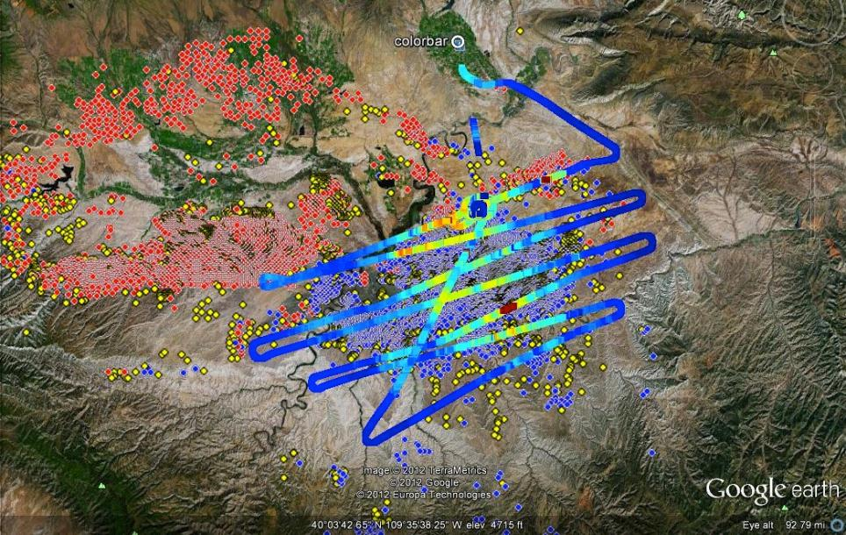
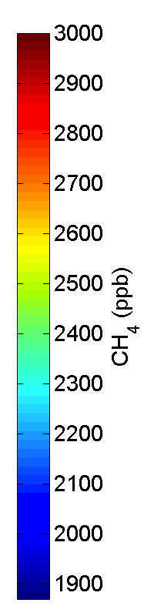

Uinta Basin’s Sea of CH₄
Flight Track color-coded by CH₄ level
Measurements on February 3, 2012 (stronger winds) suggest a leakage rate of 6-12%, compared to the EPA national average of 1.5% and the WRAP regional estimate of flaring and venting of 5.07% on Federal Land [Karion et al., GRL, 2013].
2/7/2012
Low wind
Gas wells
Oil wells
Permitted wells
No other large scale activity besides oil and gas production in the area.

Slide 17
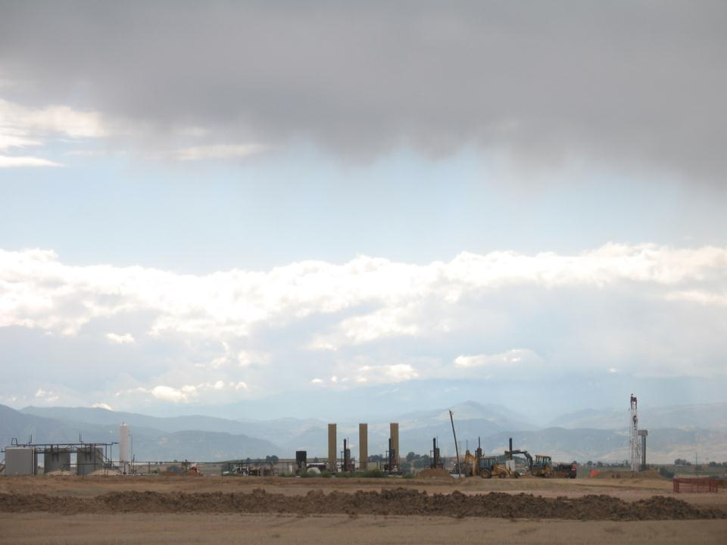
Conclusions
Atmospheric measurements can provide an independent evaluation of emission inventories.
Methane emissions from natural gas operations in some regions in the US may be higher than estimated by regulatory inventories.
A significant fraction of emissions could be avoided.
Methane is not regulated, however US EPA’s New Source Performance Standards for oil and gas operations VOC emissions will have the co-benefit of reducing CH₄ emissions.
Best management practices if used can reduce emissions.
Beyond the question of natural gas GHG emissions, there are some other pressing (related) questions about energy choices, energy equality, climate change mitigation and adaptation at home and around the world.

Slide 18
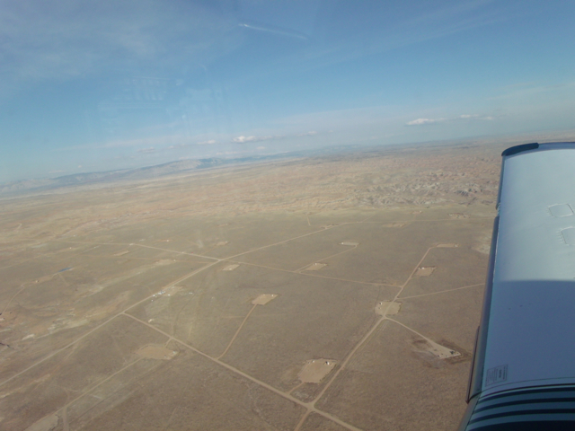
Resources
Health Impact Assessment: Colorado School of Public Health
http://www.garfield-county.com/environmental-health/battlement-mesa-health-impact-assessment-ehms.aspx
Risk of Silicosis during well stimulation: Esswein et al, JOEH
http://oeh.tandfonline.com/doi/abs/10.1080/15459624.2013.788352#.Uib1jLwmz66
Western Regional Air Partnership – Air Emissions from O&G
http://www.wrapair2.org/PhaseIII.aspx
EPA GHG inventory and GHRP
http://www.epa.gov/climatechange/ghgemissions/

Slide 19
Extra-Slides

Slide 20
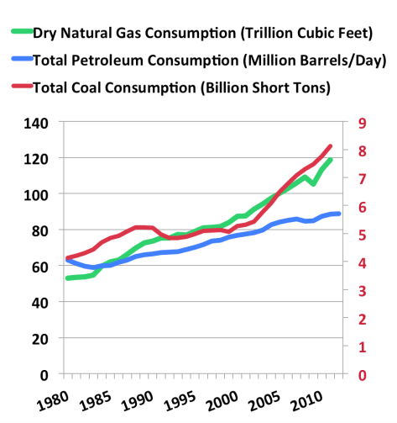
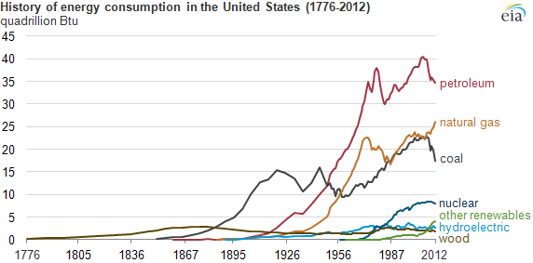
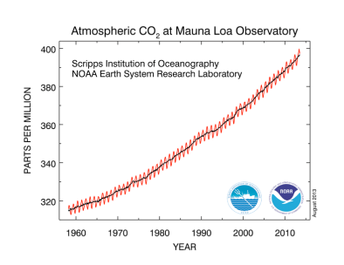
No clear path towards zero carbon energy world
Globally, consumption of both coal and natural gas is rising!
Natural gas is displacing coal in the US for now…
The Era of fossil energy is still strong!
EIA, International Statistics

Slide 21
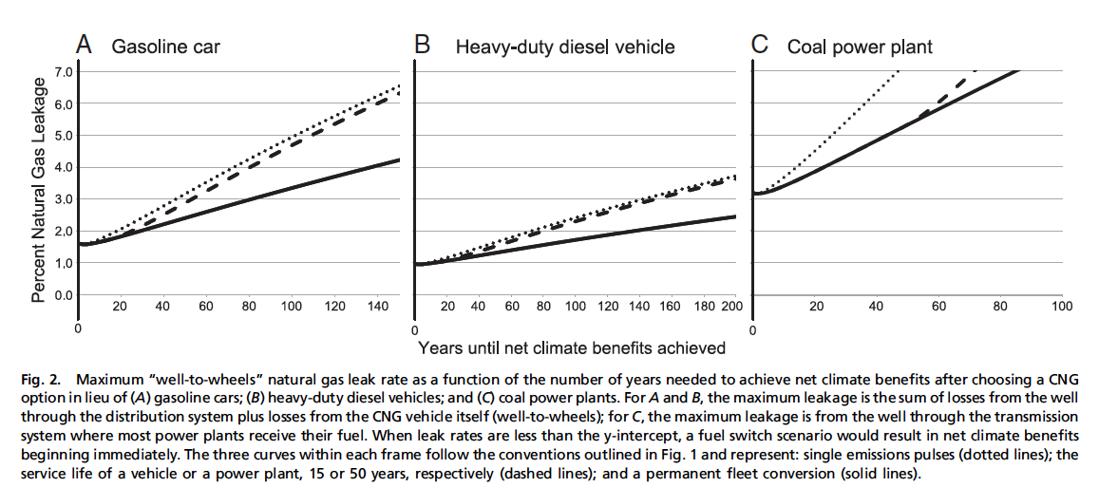
Time frame for climate benefits of switching to natural gas for various leakage rates
Source: Alvarez et al., PNAS, 2012

Slide 22
US EPA CH₄ emissions estimates from NG production operations
Reported 2σ: 20−30%
Notes:
http://energyindepth.org/national/epas-massive-downward-revision-of-methane-emissions/

Slide 23
Conventional and unconventional gas
Conventional natural gas deposits have been the most practical and easiest deposits to mine
Unconventional gas refers to gas that is more difficult or less economical to extract.
Extraction in the unconventional low permeability formations requires
hydraulic fracturing.

Slide 24
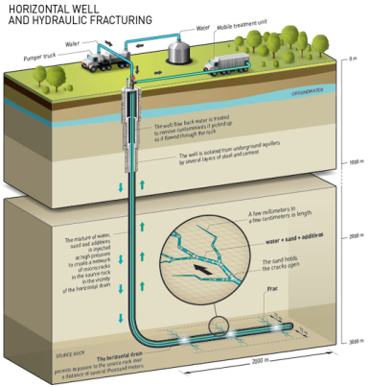
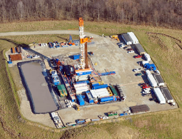
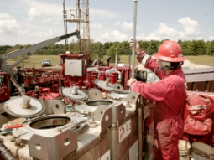
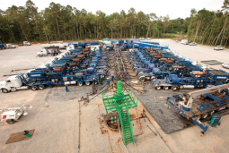
Principle of Hydraulic Fracturing
Hydraulic fracturing or "fracking" is a stimulation technique used to increase the amount of natural gas or oil that can be extracted from compact formations.
Fracking consists in injecting millions of gallons of water mixed with sand (9.5%) and chemical additives (0.5%) down the hole. The high pressure mixture causes the rock layer to crack. The natural gas present in very fine pores can flow to the well head via the fissures which are held open by the sand particles.
Source: Total

Slide 25
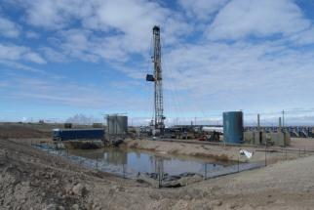
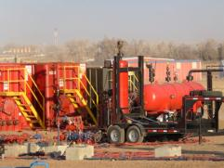
Example of Oil & Gas Production Source Categories
Source: Tom Moore
Western Regional Air Partnership
Large Point Sources
(Gas plants, compressor stations)
Drill Rigs
Wellhead Compressor Engines
CBM Pump Engines
Heaters
Pneumatic Devices
Condensate and Oil Tanks
Dehydrators
Completion Venting
Lateral compressor engines
Workover Rigs
Salt- Water Disposal Engines
Artificial Lift Engines (Pumpjacks)
Vapor Recovery Units (VRU’s)
Miscellaneous or Exempt Engines
Flaring
Fugitive Emissions
Well Blowdowns
Truck Loading
Amine Units (acid gas removal)
Produced Water Tanks
Flowback, Utah, 2012
Pit and open-top tank
Flowback, CO Front Range, 2013
“green” completion

Slide 26
Potential Air Impacts of (Shale) Gas/Oil Development:
[CH₄] going up and ¹³C going down
Likely linked to changes in natural sources
NOAA/INSTAAR global network data
Climate Forcing Methane
Carbon dioxide
Global Scale
O&G emissions are partly (entirely) responsible for surface O₃ pollution events in Colorado Front Range (Uinta Basin, Green River Basin)
Schnell et al., 2009; Gilman et al., 2013
Air Quality
Ozone
Regional Scale
Health
Air Toxics, Ozone
Particles
Local-Regional Scale
Potential for increased exposure to carcinogenic compounds esp. during completion (McKenzie et al., 2012)
Risk of exposure to silica, H₂S, PM, O₃

Slide 27
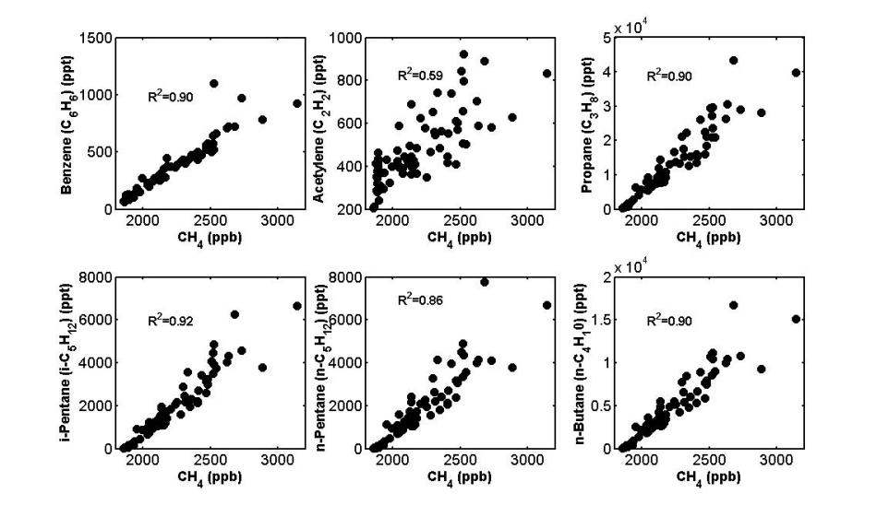
Uinta Basin: Many other hydrocarbons are emitted with CH₄
February 2012
One area source: oil and gas operations

Slide 28
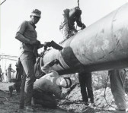
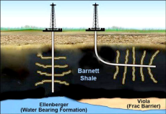
US Natural Gas Statistics
The US became the world’s largest gas producer in 2009.
1980s-Today:
Advances in horizontal drilling & hydraulic fracturing
1970s-1990s
DOE research programs
Shale gas and coalbed methane
1950s-1960s
Buildup of pipeline network
Consumption
2006-Today Boom in shale gas E&P
Late 1990s/Early 2000s
Success of Mitchell/Devon Energy in Barnett Shale
Ohio historical society
2000-2008
Price of gas increases steeply
Dry Production
Net Imports
Energy Information Administration, 2013 statistics

Slide 29
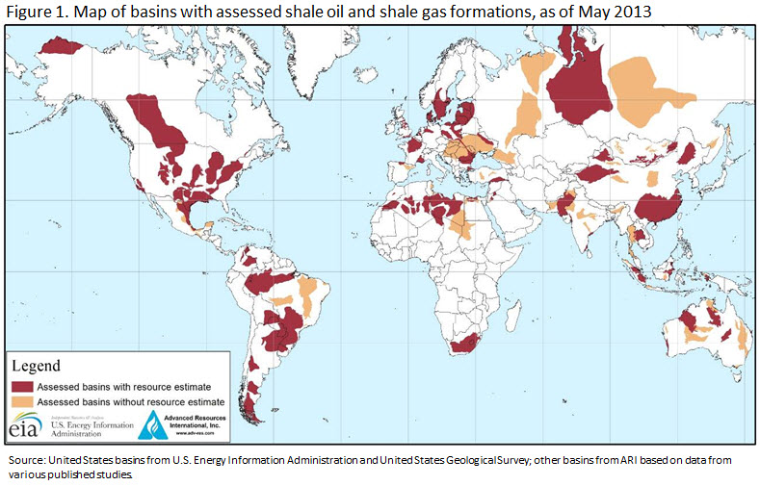
Shale Gas Around the World

Slide 30
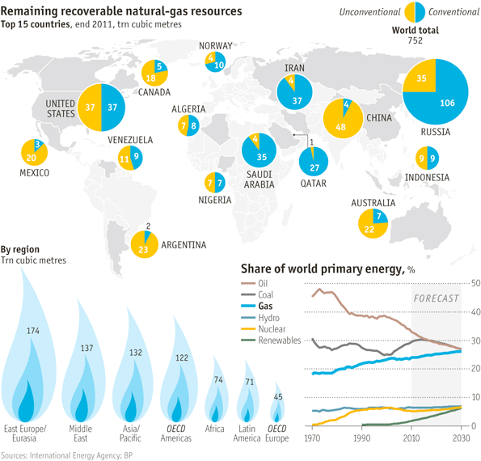

Slide 31
*
*
*
EIA International Statistics

