Slide 1
Aviation & Climate Change: CO₂ & other impacts
21 October 2015
Professor Alice Bows-Larkin & Dr Michael Traut

Slide 2
Influencing the future
Decisions made now impact on future climate adaptation
Higher Mitigation = Lower Adaptation
Lower Mitigation = Higher Adaptation
There isn’t a ‘no climate change’ future

Slide 3
Framing
We are committed to make our fair contribution to…
“To hold the increase in global temperature below 2 degrees Celsius, and take action to meet this objective consistent with science and on the basis of equity”
Copenhagen Accord, 2009
2°C is taken as the threshold between dangerous and acceptable climate change.

Slide 4
4°C CO₂
Historical CO₂
2°C CO₂
Notes:
Anderson & Bows, 2011, Beyond dangerous climate change: emission scenarios for a new world, Phil. Trans. R. Soc. A 2011 369, 20-4
… 66% chance of avoiding 2°C

Slide 5
Notes:
Anderson & Bows, 2011, Beyond dangerous climate change: emission scenarios for a new world, Phil. Trans. R. Soc. A 2011 369, 20-4
… 66% chance of avoiding 2°C

Slide 6
Mitigation policies need to be delivering change in the short-term because emissions accumulate

Slide 7
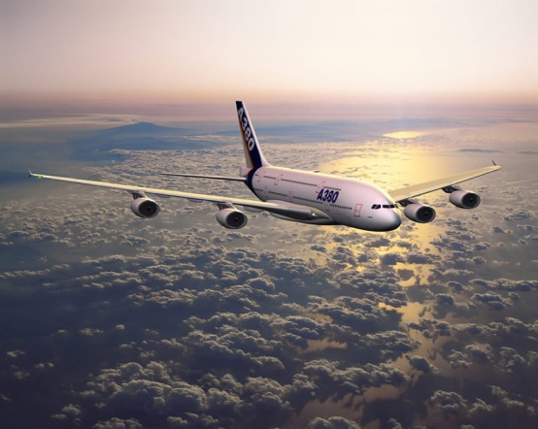
Where does aviation fit?
To avoid 2°C many nations had national targets for CO₂
International transport excluded from national CO₂ targets
International Civil Aviation Organisation (ICAO) lead mitigation

Slide 8
Global Aviation CO₂ growth
Global growth higher than aggregated all sector growth
Data from IEA statistics

Slide 9
Adapted from data within ICAO, Environmental Report. Destination green: aviation and climate change, 2013. 23-25; RCP & Anderson & Bows, 2011 and to be published in Bows-Larkin et al., 2015.
Notes:
Need to close this huge gap

Slide 10
E.g. UK aviation CO₂ proportion growing
CO₂ aviation proportion grown from 3% in 1990 to 7% in 2013
Provisional figure for 2014 – 8%
Aviation CO₂ growth negating cuts elsewhere
Greater the aviation CO₂, the less likely the UK can meet its targets

Slide 11
Challenges for aviation: - no short term technical options
Engines:
pushed hard already; open rotors – noise issues
Materials:
new designs have 50% composites – lighter
Designs – 60yr lock-in/slow fleet turnover:
remain similar to today with marginal adjustments; retrofit limit
Fuels – long term reliance on kerosene:
bio-kerosene has appeal but with sustainability concerns
Operations:
slow to change – 1 EU sky – eases congestion, supports growth
High growth:
Tends to be higher than in other sectors – most of the population don’t fly
Cause additional climate warming…
Notes:
Fuel efficiency improvements max 1-2% per year with some scope for biofuels to reduce CO₂ intensity

Slide 12
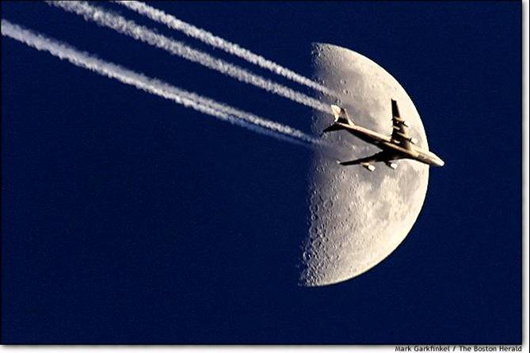
Non-CO₂ emissions from aviation
Altitude
Ozone
Contrails
Combination of effects leads to aviation contributing to an estimated double the equivalent warming of CO₂ alone to date
Cirrus clouds
Notes:
Water vapour – contrail formation; nitrous oxides form ozone (ghg) deplete methane (ghg), sulphur oxides and sulphuric acid can both cool and warm – relfect sunlight, but form contrails and increas cirrus. Soot can reflect sunlight but if fall to the ground it can cause warming, contrail formation and increas cirric

Slide 13
Why ‘uplift’ requires caution
While it is well accepted that aircraft cause additional climate warming (up to 2x impact of CO₂), policy making must consider the importance of these emissions being very different in nature and lifetime
While contrails and resulting cirrus creates warming, a change in altitude to avoid their formation will likely result in additional CO₂ – which will last +100 yrs.
Similarly, modifying engines to avoid NOx emissions, can also increase fuel burn – hence more CO₂.
The only measures that would tackle all in tandem are those focused on demand management.
Notes:
Water vapour – contrail formation; nitrous oxides form ozone (ghg) deplete methane (ghg), sulphur oxides and sulphuric acid can both cool and warm – relfect sunlight, but form contrails and increas cirrus. Soot can reflect sunlight but if fall to the ground it can cause warming, contrail formation and increas cirric

Slide 14
Headline message
Mitigating all emissions in aviation requires demand management
Notes:
If growth rates outstrip efficiency or CO2 intensity improvements, need to consider demand too
Not biofuels for a while though

Slide 15
Conclusions
‘2°C’ challenge requires cuts to all sectors
Global aviation scenarios show a considerable rise in CO₂
In many nations aviation emissions grow as a proportion of total
Incremental change insufficient for 2°C target
Not got the luxury of assuming technology will mitigate emissions
Aviation demand management must form part of the policy portfolio
Notes:
Incremental changes implemented immediately
– will fall far short of aviation’s contribution to avoiding 2°C
Radical step changes a prerequisite of any below 2°C future
– pushed as hard and as quickly as possible

Slide 16
THANK YOU.
@aliceblarkin
www.tyndall.ac.uk
www.tyndall.manchester.ac.uk
Bows-Larkin, 2014: All adrift: aviation, shipping and climate change policy, Climate Policy, http://www.tandfonline.com/doi/abs/10.1080/14693062.2014.965125.

